Slide 2
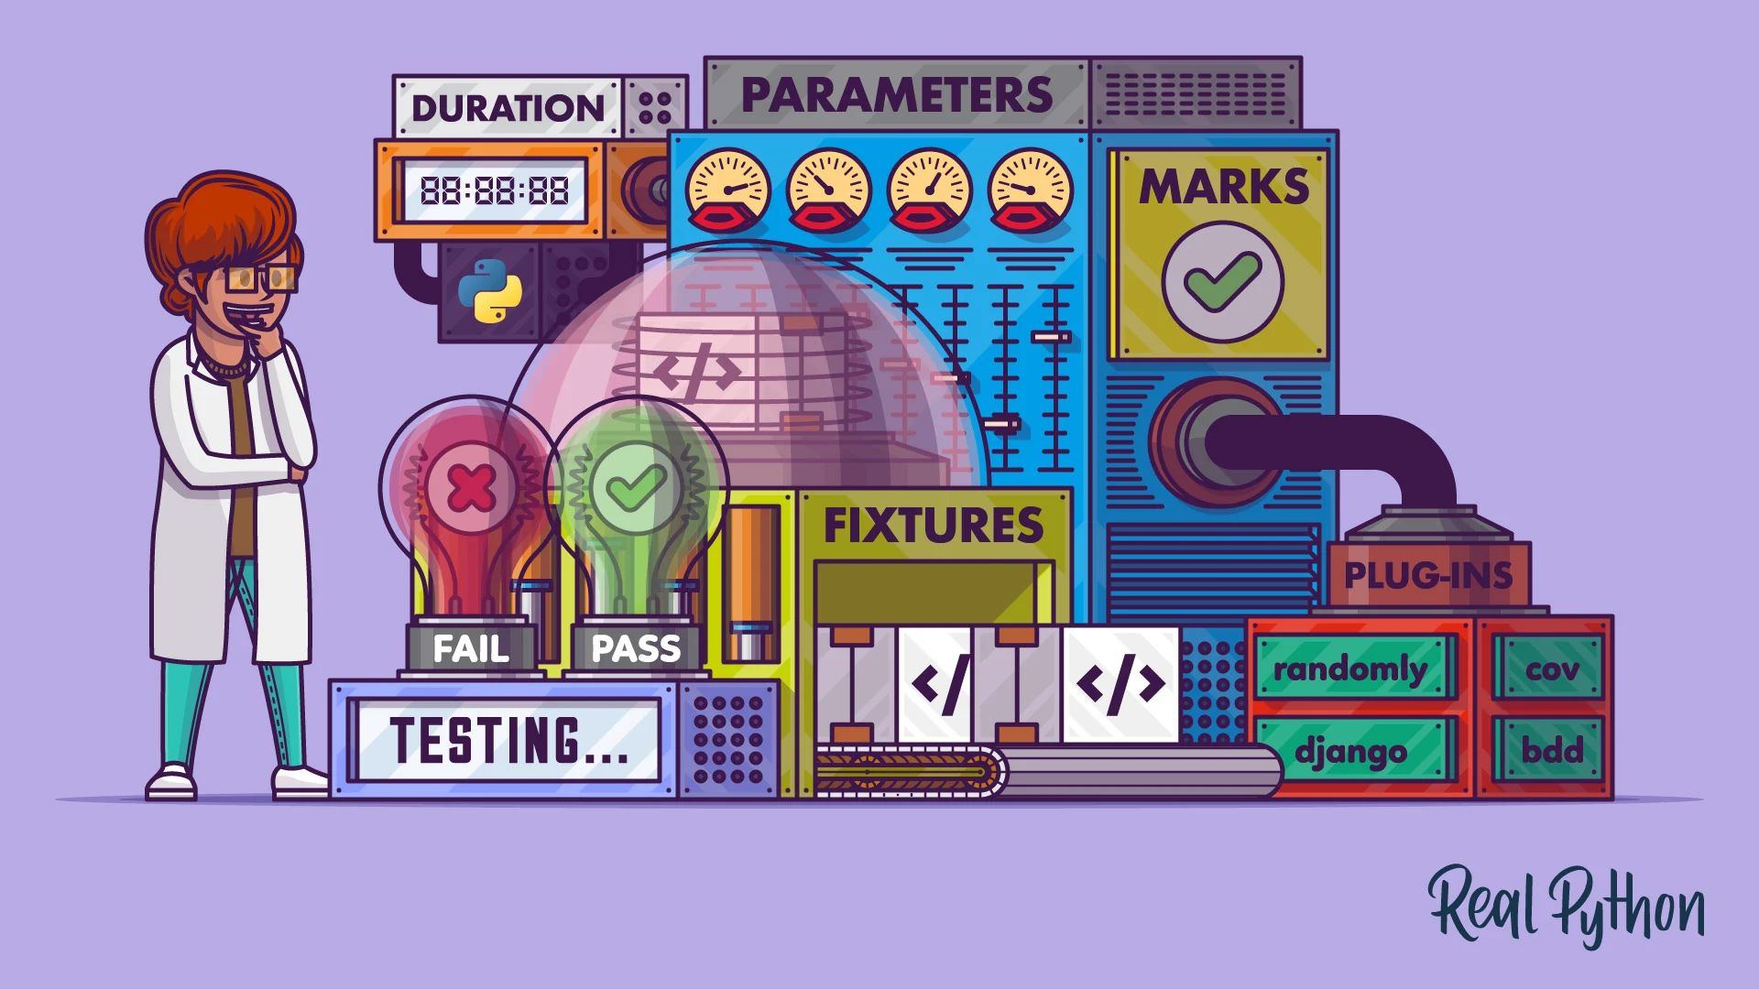
Be a Python Automation Engineer with 1 Library and 1 Beer

Slide 3



Meet the Team
Nayeli Juárez –​ Tech Lead
José Luis Becerril – Senior Test Engineer
Javier Padilla – Project Manager

Slide 4

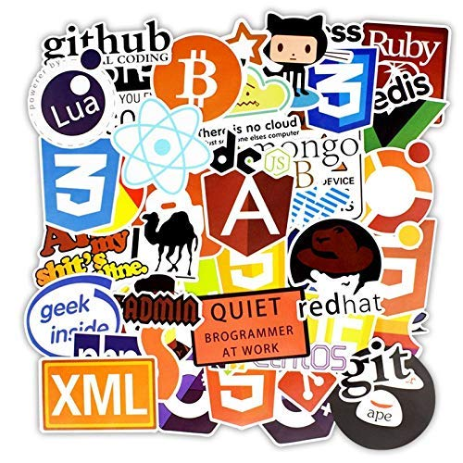
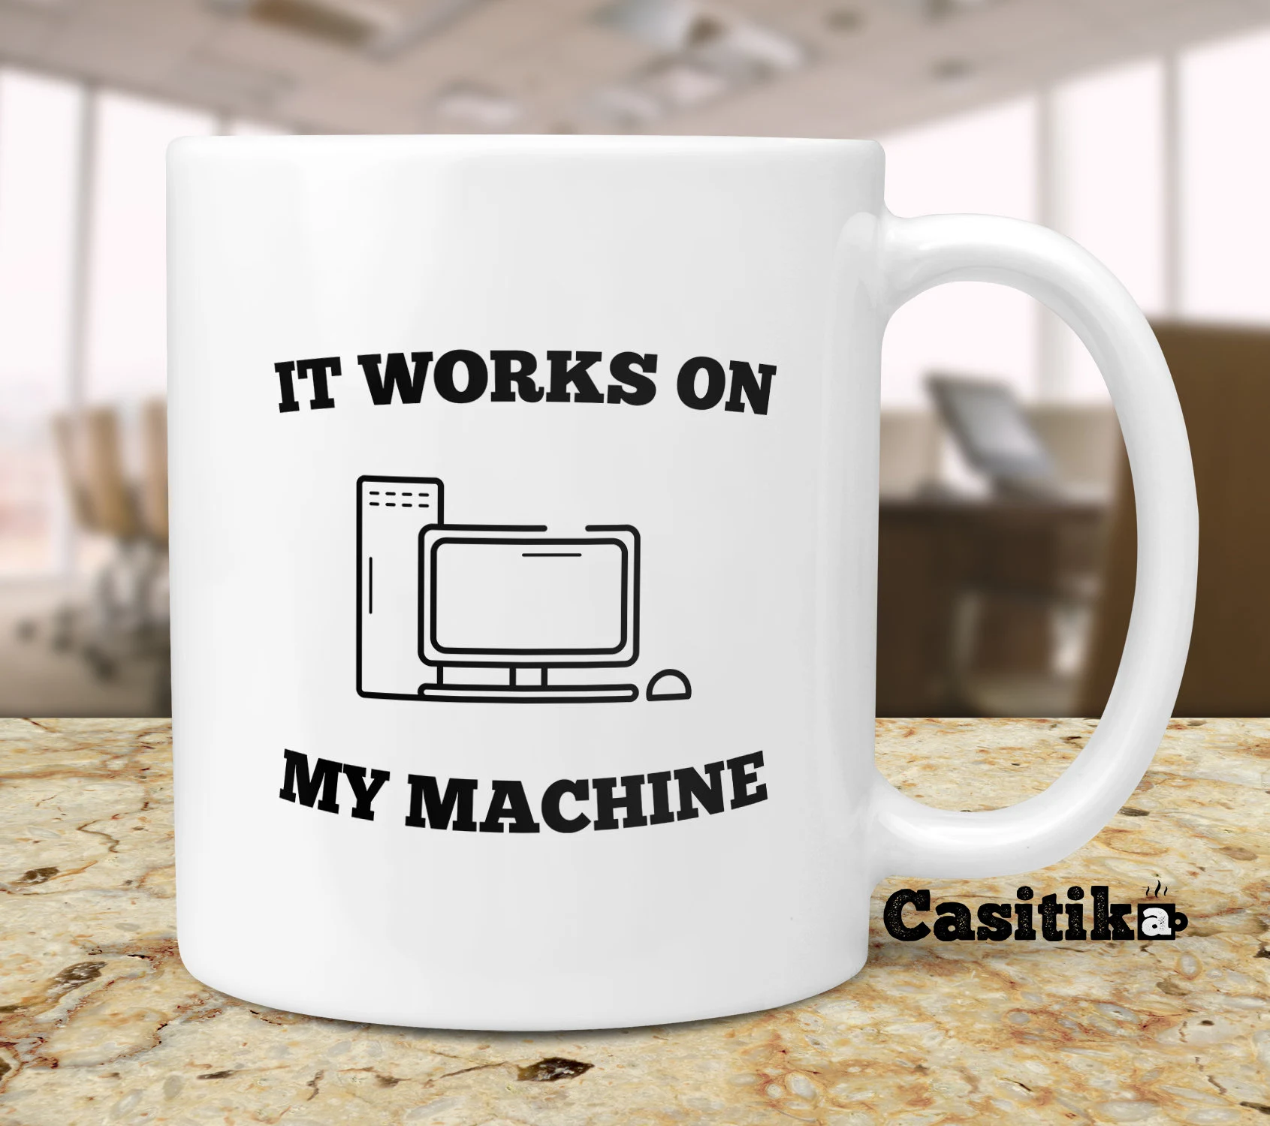

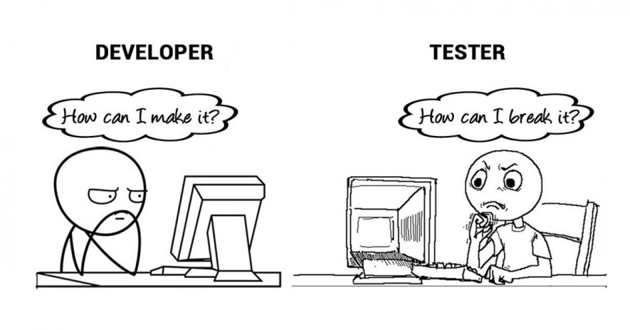

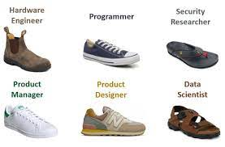

How to be a Software Automation Engineer
Be a Python Automation Engineer

Slide 5
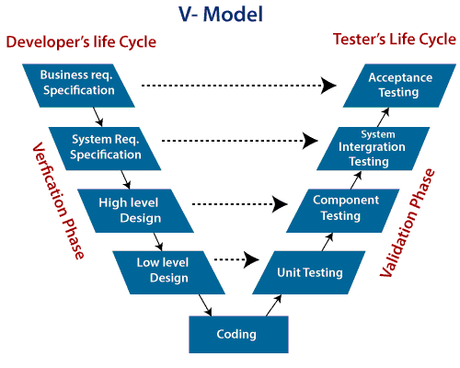
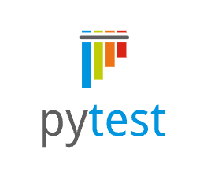
PyTest presence in the V-Model
Be a Python Automation Engineer
V Model is a highly disciplined SDLC model which has a testing phase parallel to each development phase
SDLC: SDLC is Software Development Life Cycle. It is the sequence of activities carried out by Developers to design and develop high-quality software.
STLC: STLC is Software Testing Life Cycle. It consists of a series of activities carried out by Testers methodologically to test your software product.

Slide 6
Setup for Automation Framework
Be a Python Automation Engineer
Open a GNU/Linux terminal or if you're in windows could use WSL and install
sudo apt-get install python3-venv
Create a folder into your directory local@ugc12tffz23:~/jl$ mkdir course
Move to your new folder local@ugc12tffz23:~/jl$ cd course/
Create a virtual environment local@ugc12tffz23:~/jl/course$ python3 -m venv virtual_env
Activate the environment local@ugc12tffz23:~/jl/course$ source virtual_env/bin/activate
Install your libraries (virtual_env) local@ugc12tffz23:~/jl/course$ pip install pytest
Create the structure of your classes following a Design Pattern
Notes:
Troublesooting: pip config set global.trusted-host "pypi.org files.pythonhosted.org pypi.python.org"

Slide 7
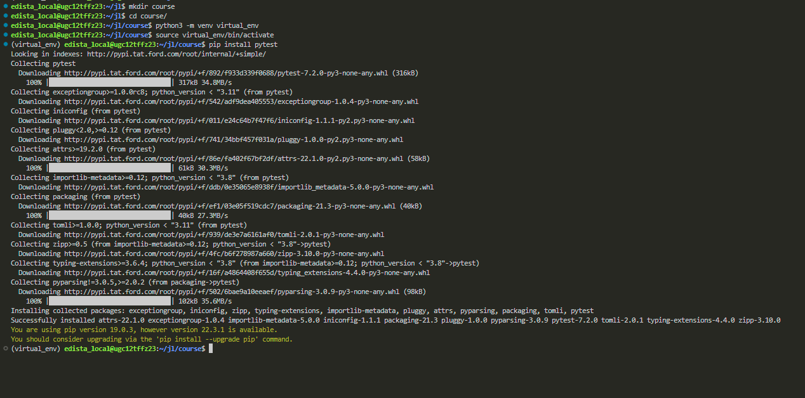
Setup Automation Framework Example
Be a Python Automation Engineer

Slide 8
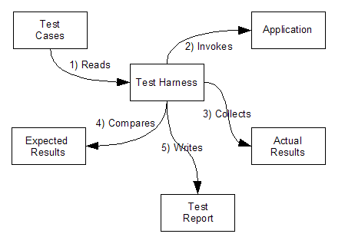
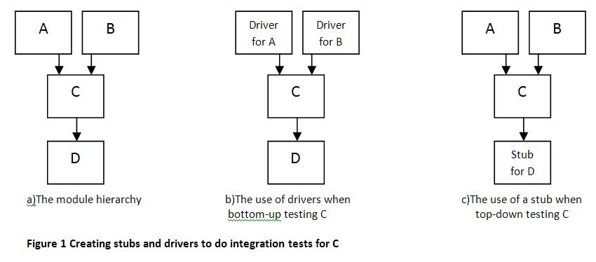
Test Automation Framework (TAF) Architectures Test Harness:
Be a Python Automation Engineer
Software Testing – Test Harness
A test harness is also called an automated test framework. In software testing, a test harness is a group of software and test data designed to test a program element by operating it under different situations and supervising its practices and results. A test harness is a software designed to ease integration testing. Is composed of drivers and stubs, which are small dummy programs that interact with the software under test

Slide 9
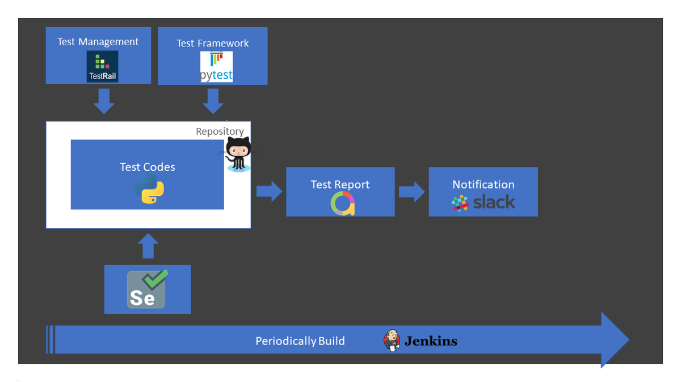
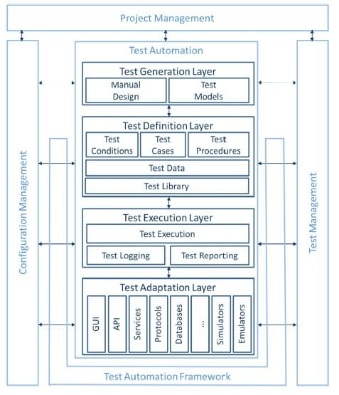
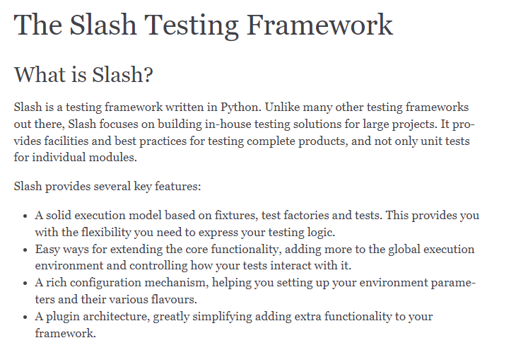
Test Framework
Be a Python Automation Engineer

Slide 10
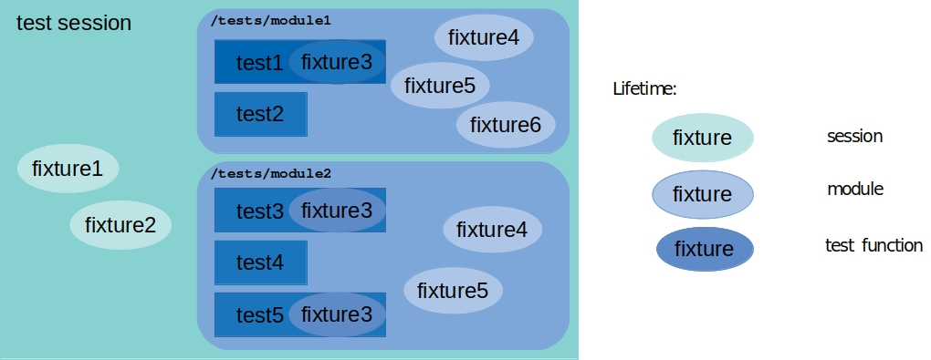
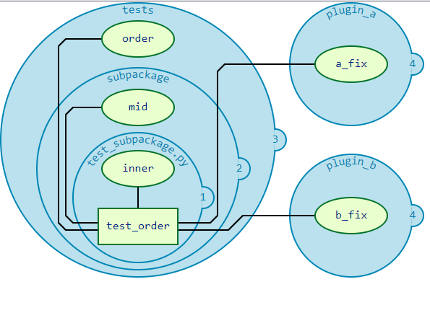
PyTest Architecture
Be a Python Automation Engineer
Fixture: Fixtures are functions, which will run before each test function to which it is applied. Fixtures are used to feed some data to the tests such as database connections, URLs to test and some sort of input data
Parametrize: Parameterizing of a test is done to run the test against multiple sets of inputs.
The builtin pytest.mark.parametrize decorator enables parametrization of arguments for a test function.
You can pass arguments to fixtures with the params keyword argument in the fixture decorator, and you can also pass arguments to tests with the @pytest.mark.parametrize decorator for individual tests.
Marking: Mark helper you can easily set metadata on your test functions.

Slide 11
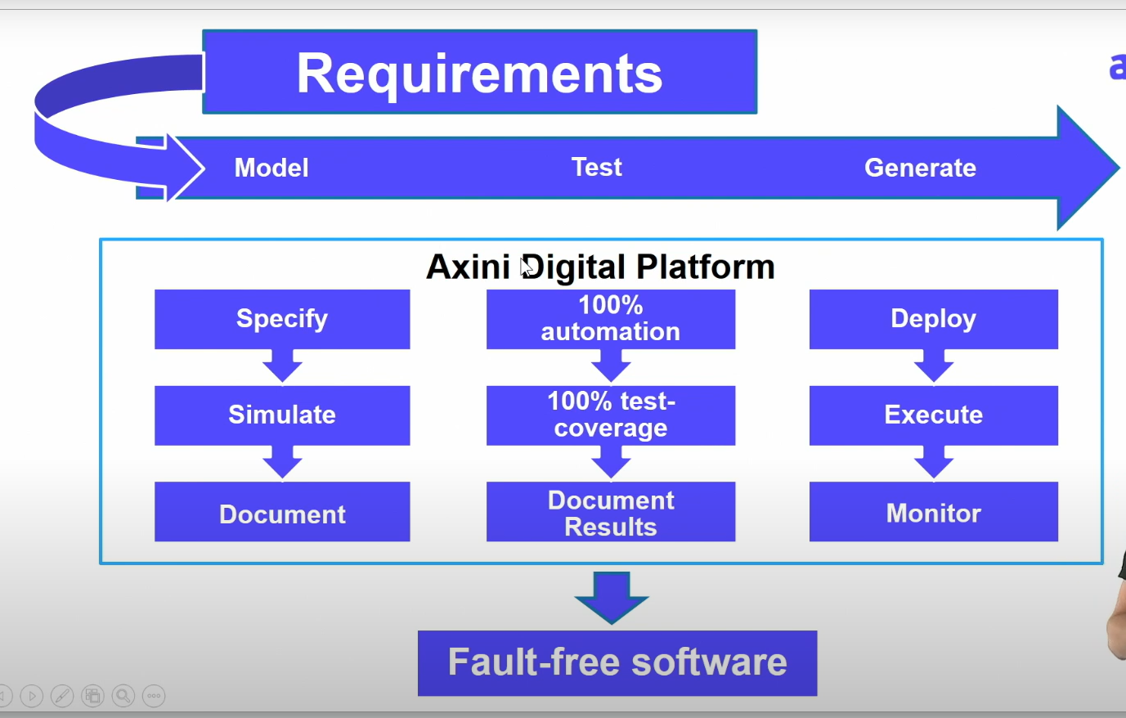
PyTest Model-Base Testing
Be a Python Automation Engineer
shorturl.at/cquv6
https://damorimrg.github.io/practical_testing_book/testgeneration/modelbased.html

Slide 12
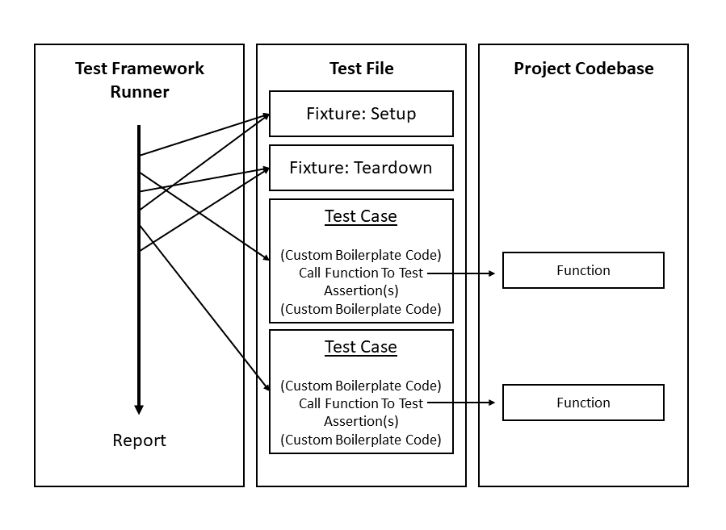
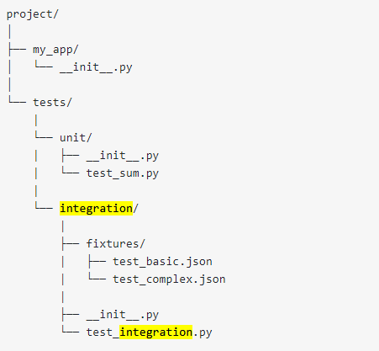
Test Case Structure
Be a Python Automation Engineer
shorturl.at/cquv6
Footnotes/references, if needed, appear here in Arial 9pt. Text grows up as lines are added. Copy and paste this box onto other slides where footnotes are needed.

Slide 13
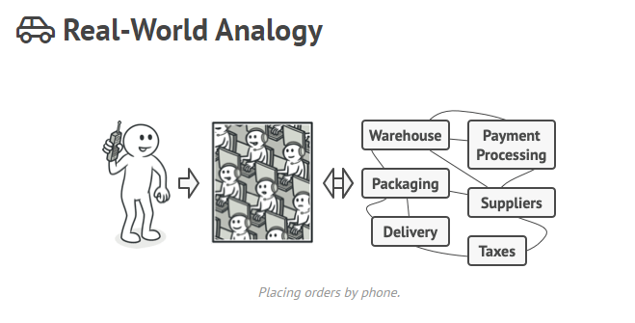
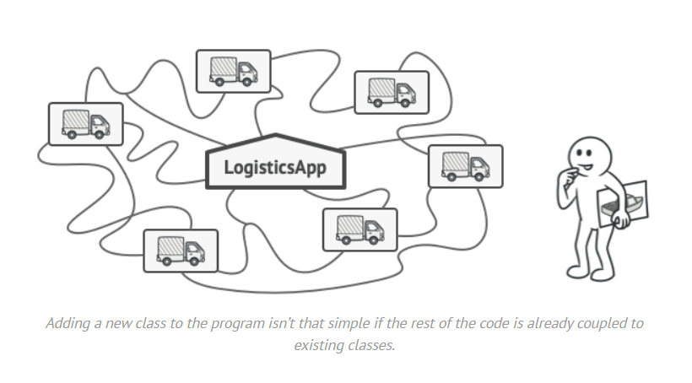
Structural Design Patter
Be a Python Automation Engineer
Facade Factory

Slide 14
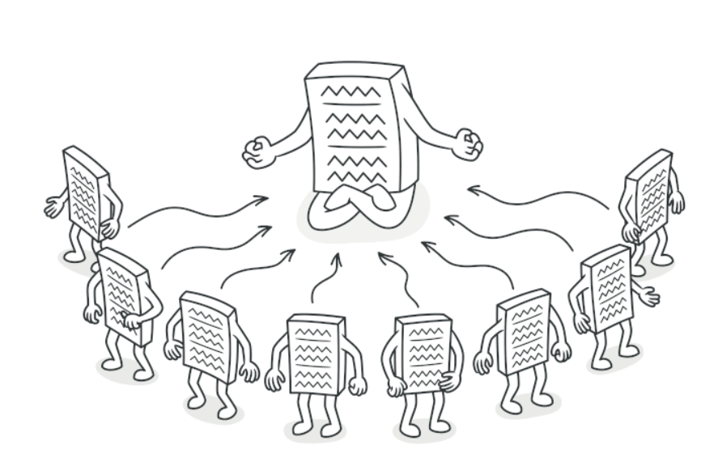
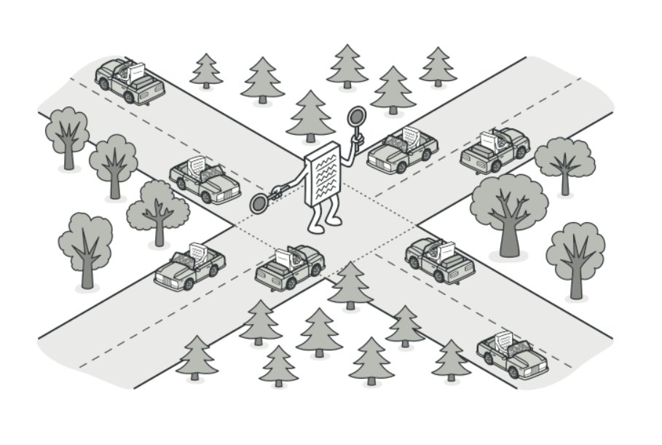
Structural Design Patter
Be a Python Automation Engineer
Mediator Singleton and or Layered

Slide 15
Regression Testing and Retesting
Be a Python Automation Engineer
Regression Testing: "Testing of a previously tested program following modification to ensure that defects have not been introduced or uncovered in unchanged areas of the software, as a result of the changes made. It is performed when the software or its environment is changed." ISTQB Glosary
Retesting: Retesting is when a test is carried out again on a specific feature that was known to not be functional during the previous test in order to check for its functionality. It is done to check that the initial bug which was found and fixed is working as it should

Slide 16
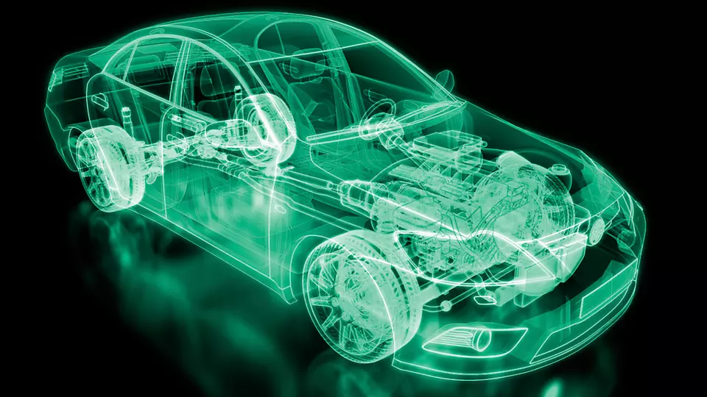
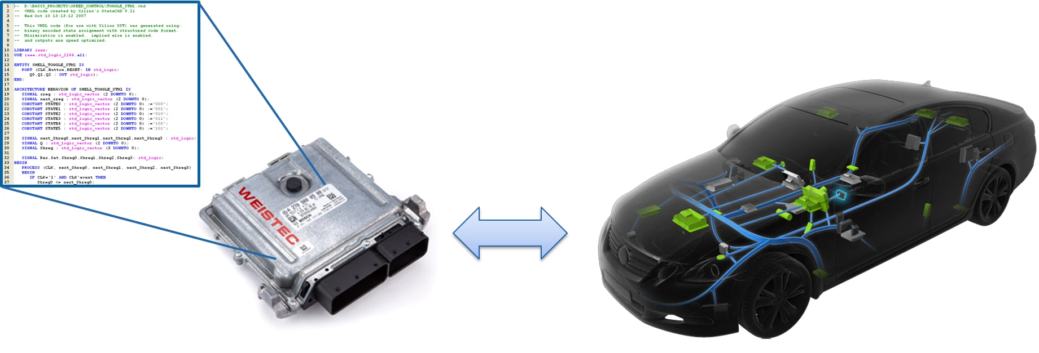
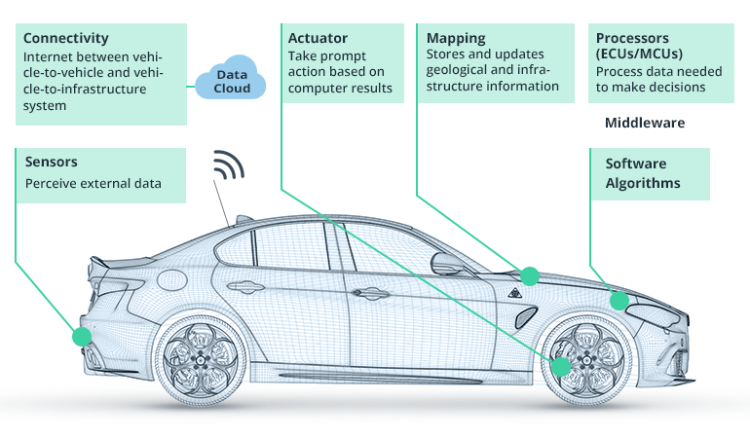
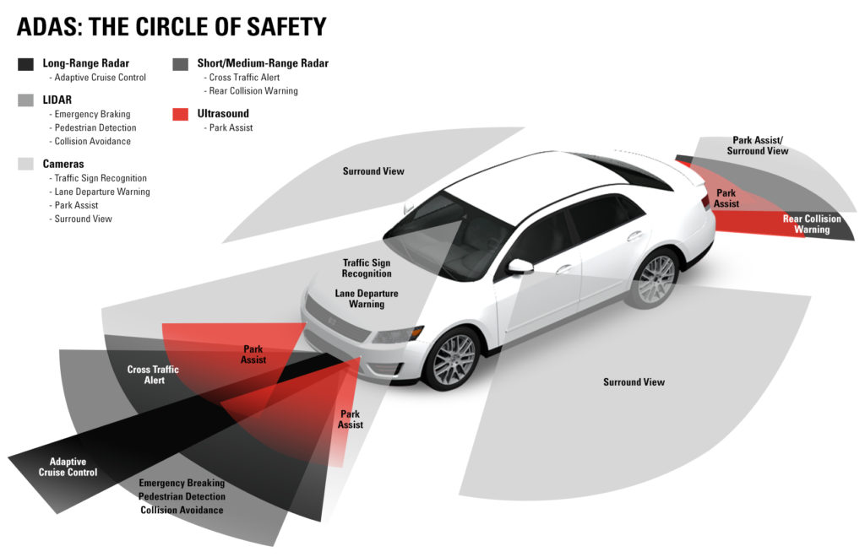
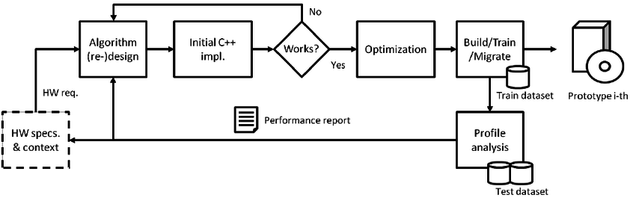
HIL – Hardware in the loop
Be a Python Automation Engineer
Hardware-in-the-loop (HIL) simulation, HWIL, or HITL, is a technique that is used in the development and testing of complex real-time embedded systems. HIL simulation provides an effective testing platform by adding the complexity of the process-actuator system, known as a plant, to the test platform.
https://en.wikipedia.org/wiki/Hardware-in-the-loop_simulation
https://www.ni.com/es-mx/solutions/transportation/hardware-in-the-loop/what-is-hardware-in-the-loop-.html

Slide 17
Automation round table
How to be ready to switch from Manual Testing to Automated testing?
What is a good criteria to select which Test cases of a suite are going to be automated and which of them are not going to be automated?
When creating a Test script, what elements are essential for a successful implementation?
What is the criteria to select parametrize test cases?
When do you recommend to use fixtures?
What logic do you use to design a Test case? Are there some methods from ISTQB foundations? Or Do you use some methods based in experience?

Slide 18

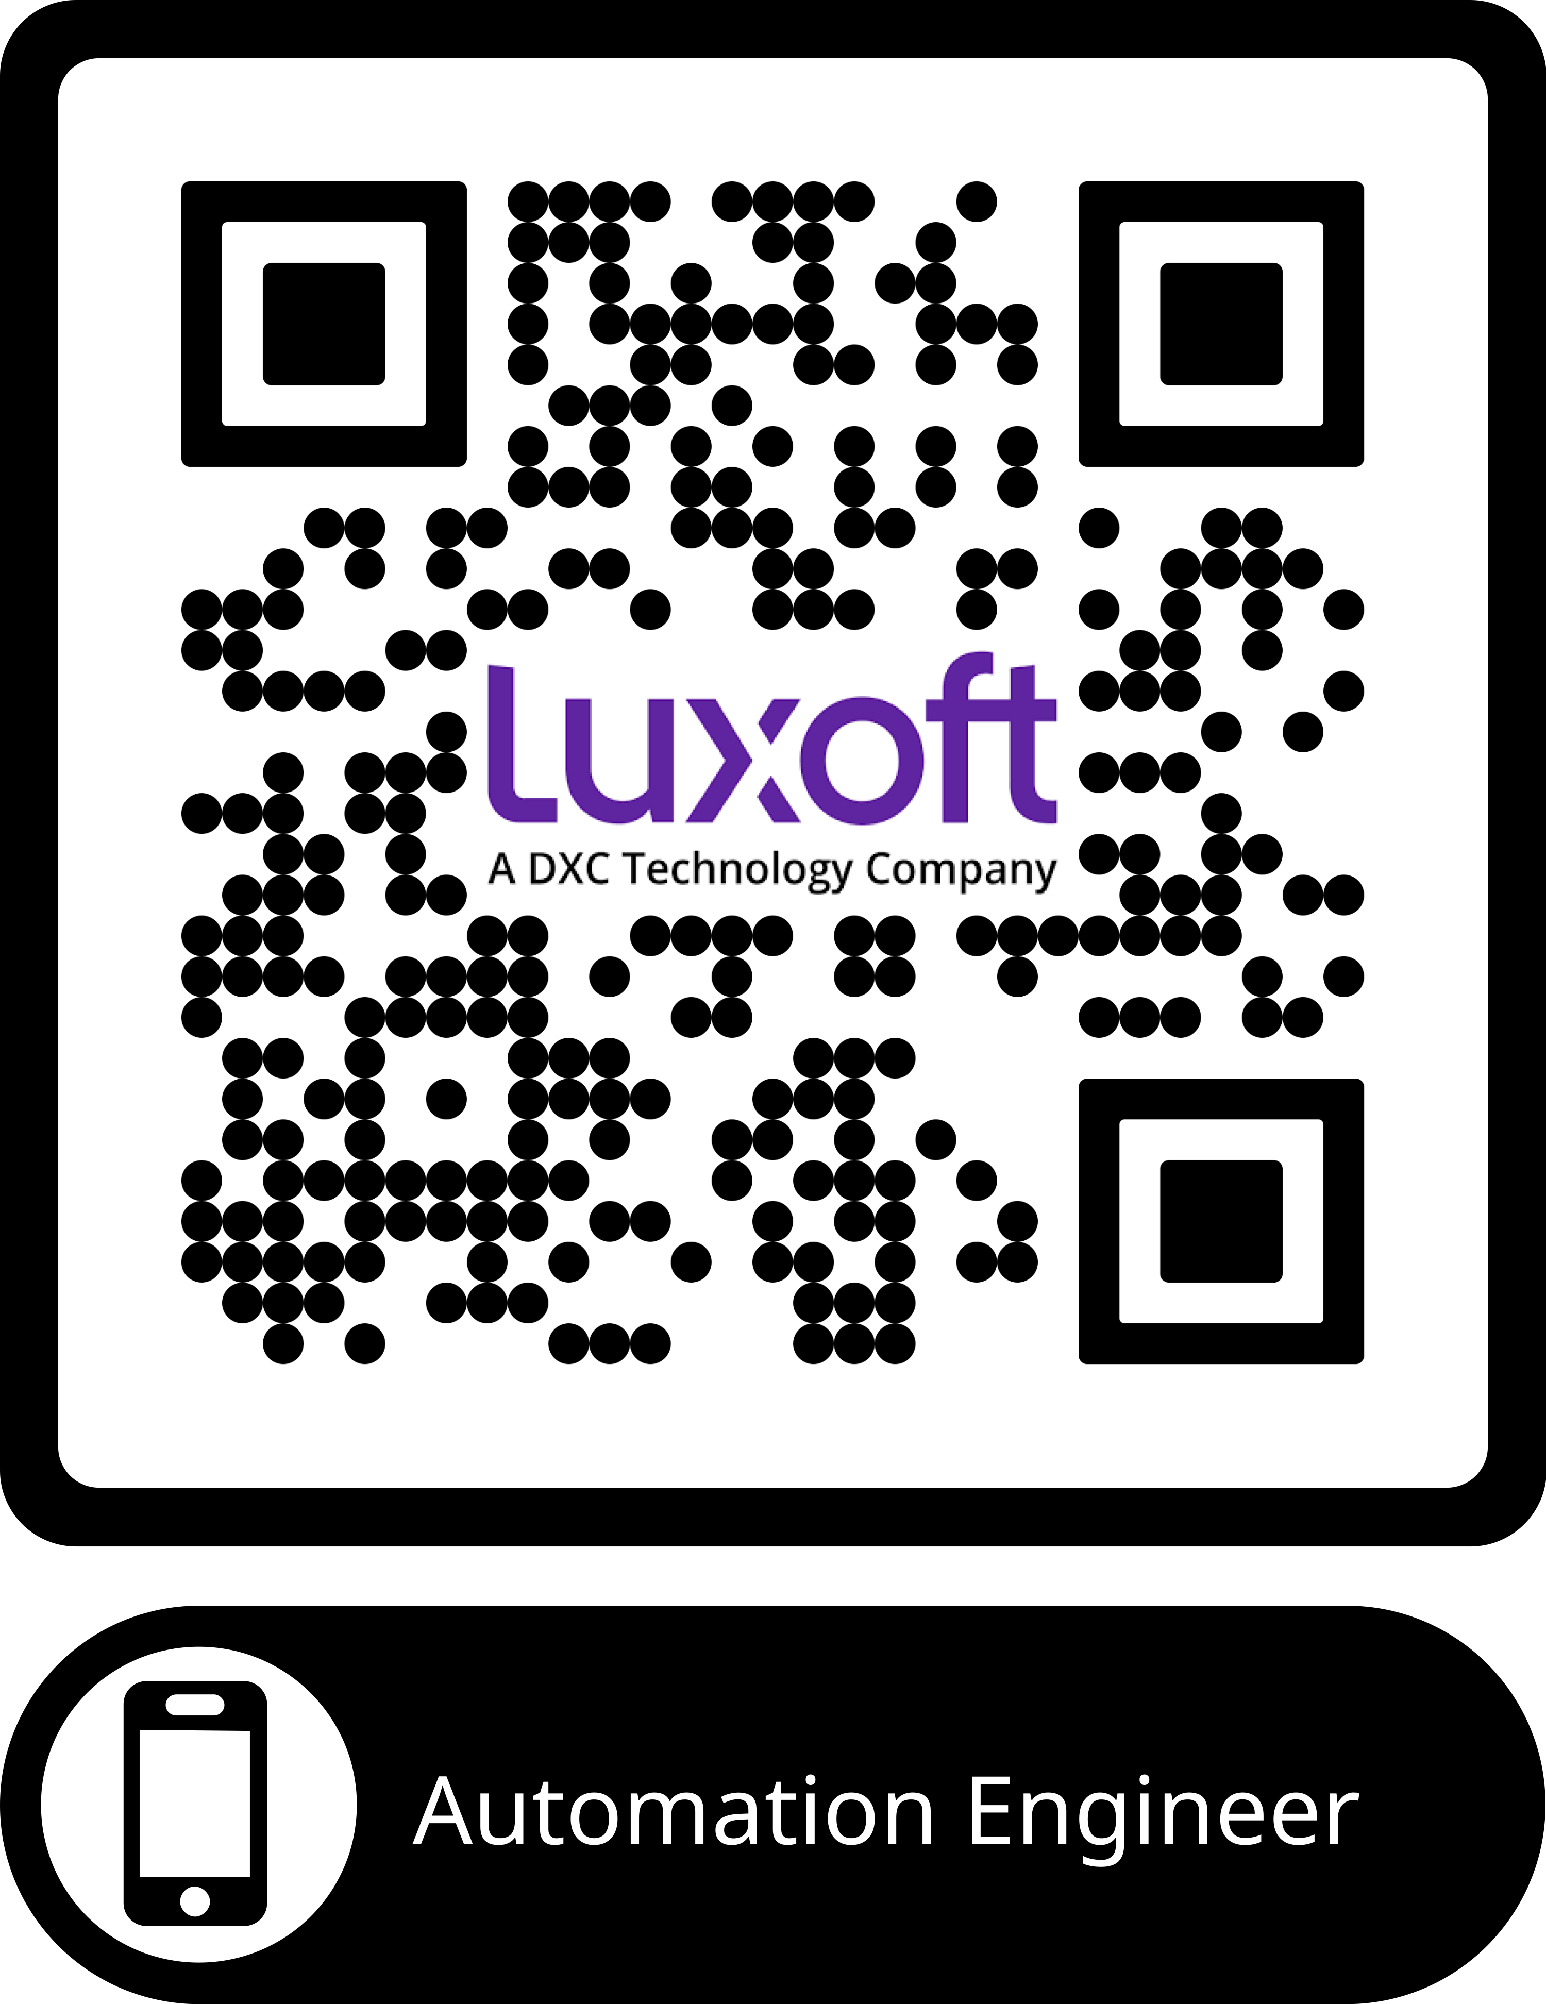

Thank you Reclutamiento:
marco.cuellarcastro@dxc.com
332-200-7922

